Slide 1
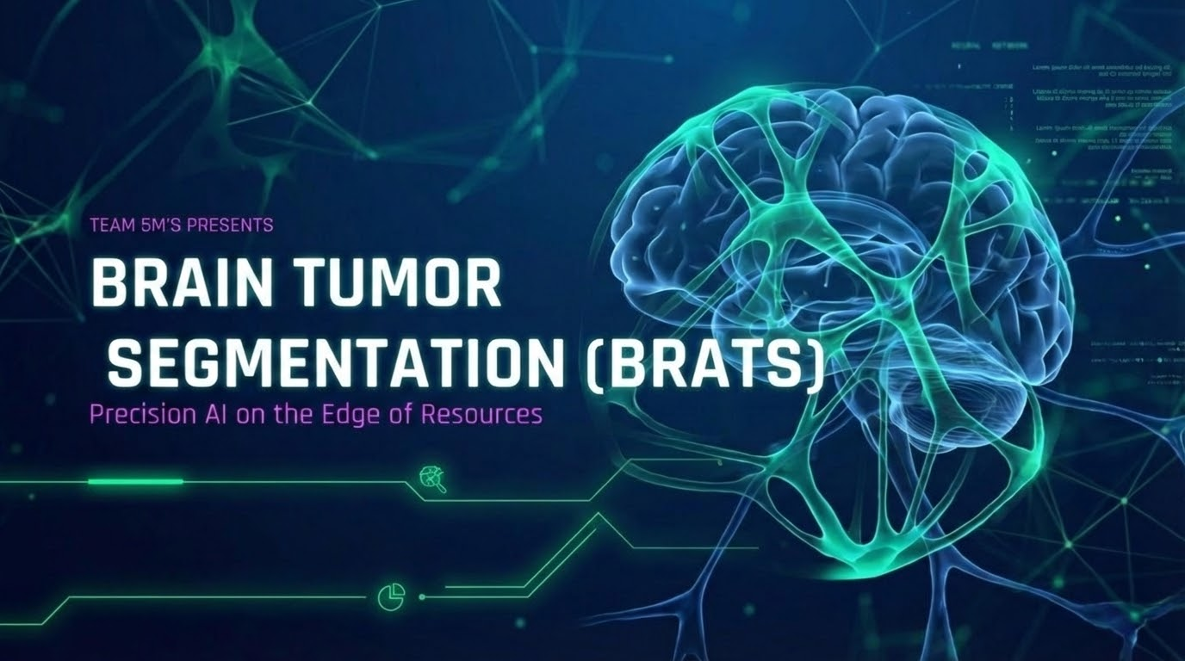



Slide 2


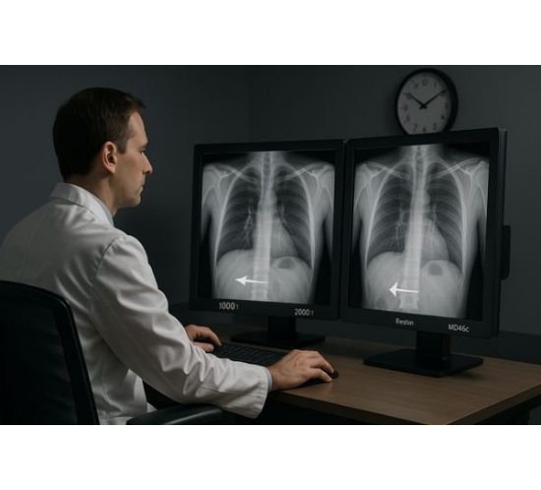
THE MEDICAL REALITY
WHY THIS MATTERS?
Radiologist Burnout: Hours spent manually segmenting tumors slice-by-slice leads to fatigue.
Volume Overload: A single patient scan contains hundreds of 3D MRI slices.
Human Error: Fatigue increases the risk of missing tiny tumor fragments in complex volumetric data.

Slide 3
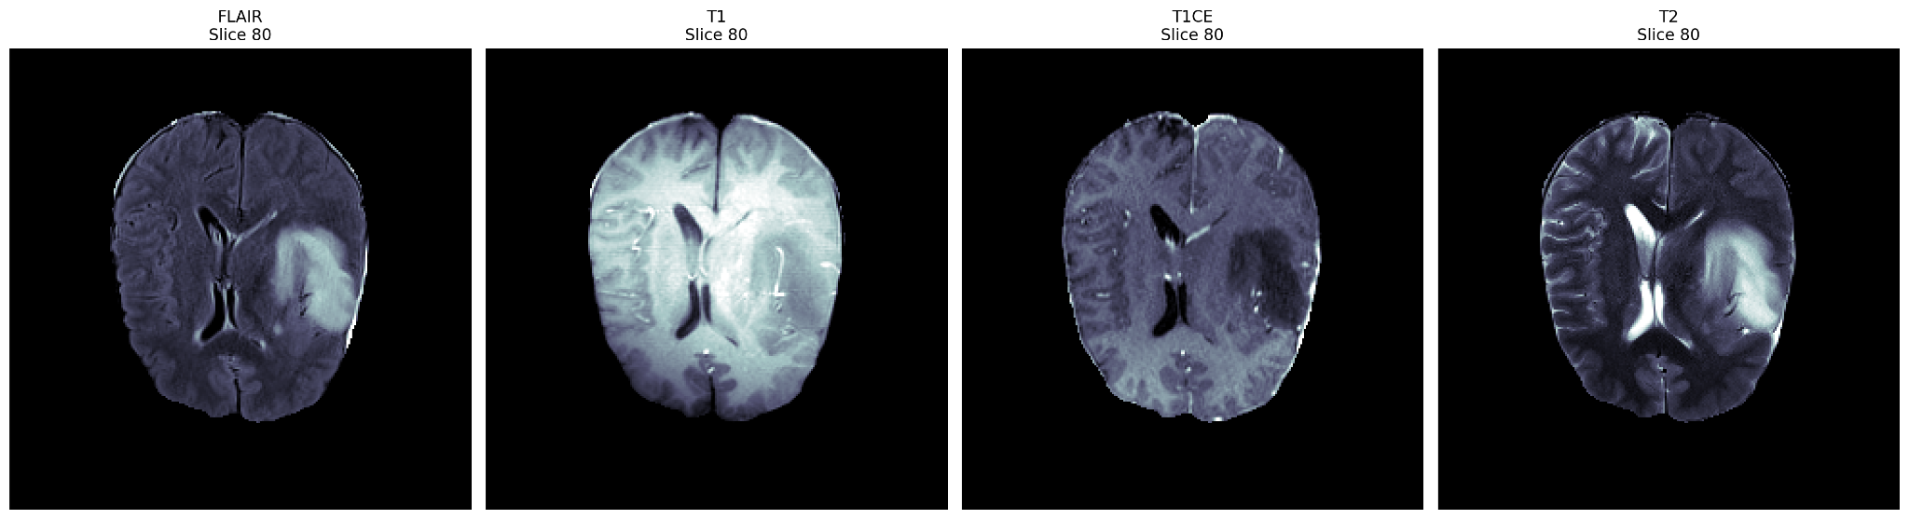
The Four Core MRI Sequence
FLAIR
T1
T1CE
T2

Slide 4


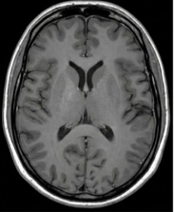
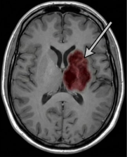
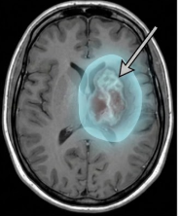
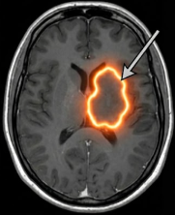


SEGMENTATION CLASSES
Background
Necrotic Tumor Core (NCR)
Represents healthy brain tissue or surrounding air. It is the majority class in most MRI scans.
The dead tissue inside the tumor. Often appears dark in T1-weighted images due to lack of blood flow.
Peritumoral Edema (ED)
GD-enhancing Tumor (ET)
The fluid-filled swelling surrounding the tumor. Indicates the brain's inflammatory response.
The active, growing part of the tumor. Shows high contrast enhancement due to blood-brain barrier breakdown.

Slide 5
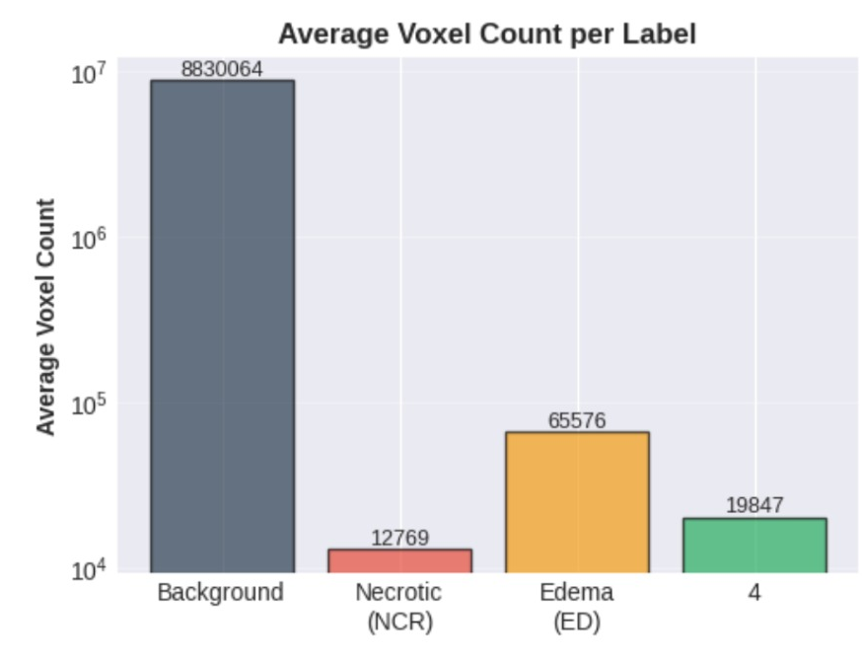
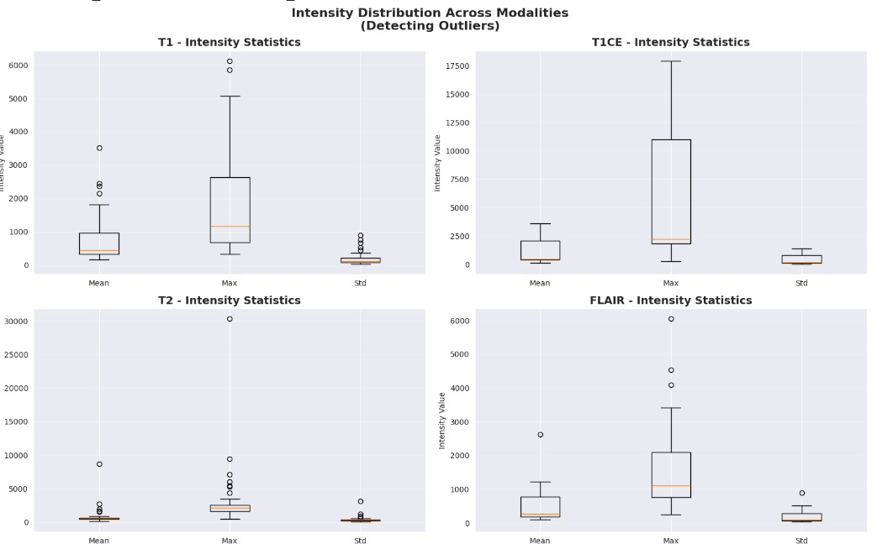
Data Exploration
Inbalance
Outliers

Slide 6






CHALLENGES WE FACED
Unorganized Data
Severe Imbalance
Intensity Variations
MRI data for each patient was stored in inconsistent folder formats with varying naming conventions.
Tumors occupy a very small area compared to the brain volume. Most slices are empty background.
Different scanners produce different intensity ranges, leading to extreme outlier pixel values.
•
Inconsistent folders
•
Background dominance
•
Scanner differences
•
Naming chaos
•
Small tumor ROI
•
Outlier pixels
•
Loading difficulties
•
Empty slices
•
Normalization issues

Slide 7
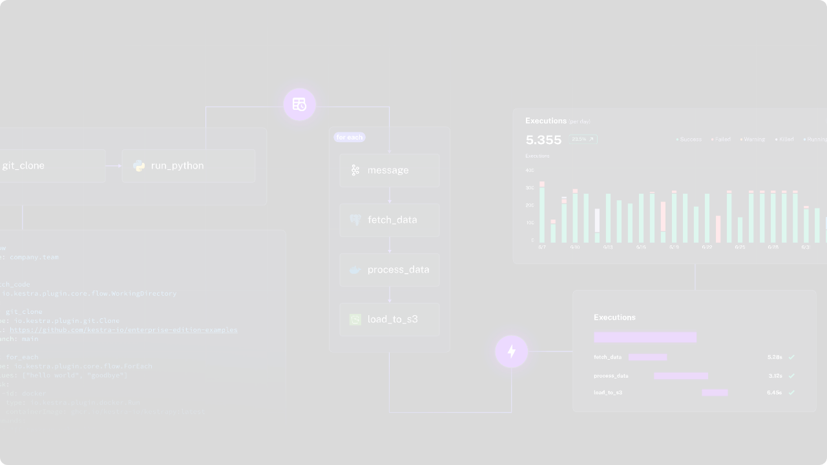








Our Solution And Pipeline
Smart Dataset Loader
Brain-Focused Cropping
Automated script to traverse patient folders, detect modalities, and organize data, reducing manual effort.
Removes unnecessary background to focus training on brain tissue, increasing the tumor-to-background ratio.
Smart Slice Sampling
Robust Normalization
Selects balanced slices (tumor-present vs. tumor-absent) to improve learning stability and performance.
Applied per-modality normalization using 1st and 99th percentiles to standardize intensity ranges [0, 1].

Slide 8
STRATEGY 1: SMART DATA SAMPLING
THE "75-SLICE" PROTOCOL
We focused training exclusively on the central 75 slices where the tumor mass typically resides. This increased information density and dramatically accelerated convergence.
The Fix: 90% of an MRI volume is black background or healthy tissue. Feeding this "empty" data wastes compute.

Slide 9
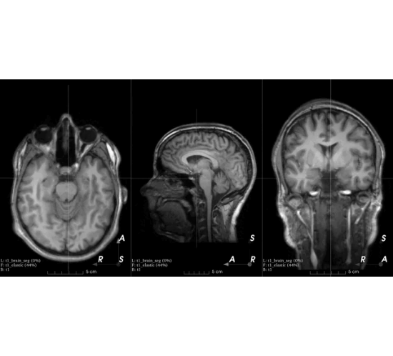
STRATEGY 4: HEAVY AUGMENTATIONS
PREVENTING OVERFITTING
With a limited dataset, neural networks tend to memorize images. We used Albumentations to artificially expand our dataset.
•
Rotation & Flips: Simulating different patient orientations.
•
Elastic Transforms: Simulating natural biological variances in brain shape.

Slide 10
Architecture
https://manus.im/share/file/d4ee39b9-6257-4a90-abb0-4dda84d64240

Slide 11
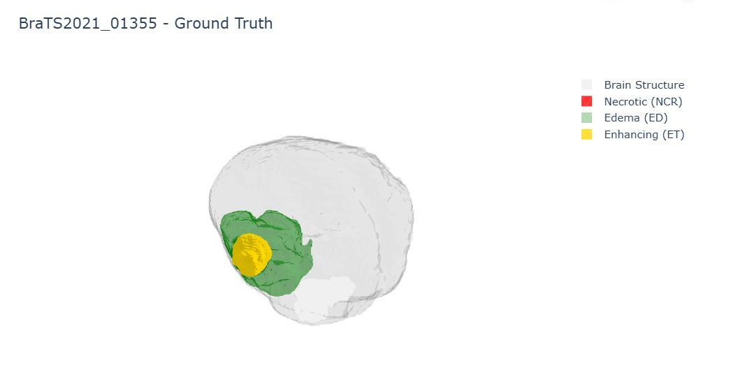
Model Results

Slide 12
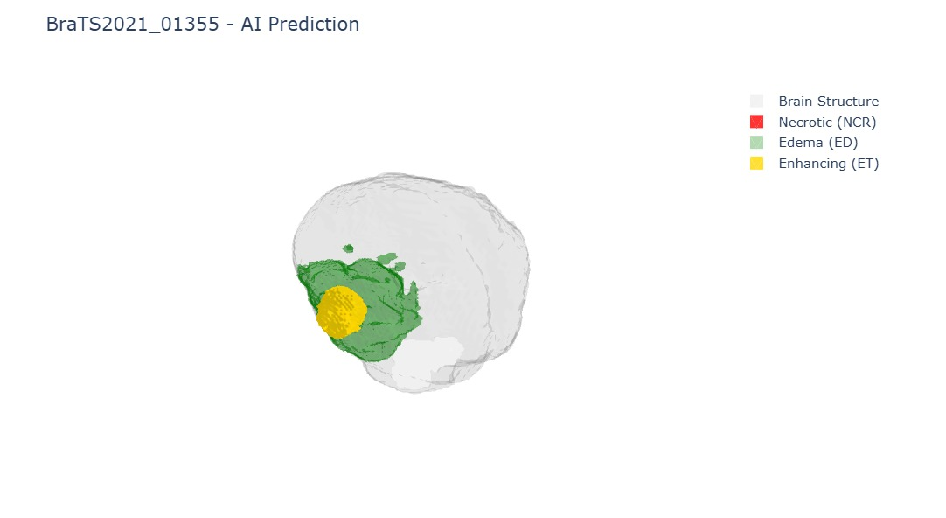
Model Results

Slide 13
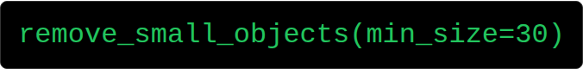
THE "SECRET SAUCE": INFERENCE PIPELINE
THE CLEANING ALGORITHM
How we fixed the low score and removed noise.
"If it's dust, sweep it."

Slide 14






TEST-TIME AUGMENTATION (TTA)
1. PREDICT
2. FLIP & PREDICT
3. AVERAGE
Run inference on the original image.
Flip the image, predict again, and flip back.
Average the predictions. Result: Smoother boundaries and higher confidence.

Slide 15





THE second failure THE NAIVE APPROACH
3D U-NET
MEMORY CRASH
ITERATION BLOCK
Attempted to train a standard 3D U-Net on full MRI volumes.
Immediate CUDA OOM errors. The model was too heavy for the hardware.
Extremely slow training times made rapid experimentation impossible.

Slide 16


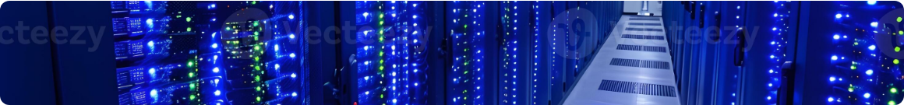
THE "KAGGLE" BOTTLENECK
LIMITED RESOURCES
THE 3D CHALLENGE
We didn't have unlimited cloud compute or H100 clusters. We were constrained to standard Kaggle GPUs (P100/T4) with limited VRAM (16GB).
Processing full 3D volumetric MRI data requires massive memory. Feeding entire volumes resulted in immediate Out of Memory (OOM) errors.

Slide 17

DEPLOYMENT: BEYOND THE NOTEBOOK
PRODUCTION-READY AI
Backend: FastAPI for high-performance inference.
Docker: FastAPI for high-performance inference.
Frontend: React dashboard for doctors.
Visualization: Integrated 3D interactive viewer for exploring segmented tumor volumes.

Slide 18
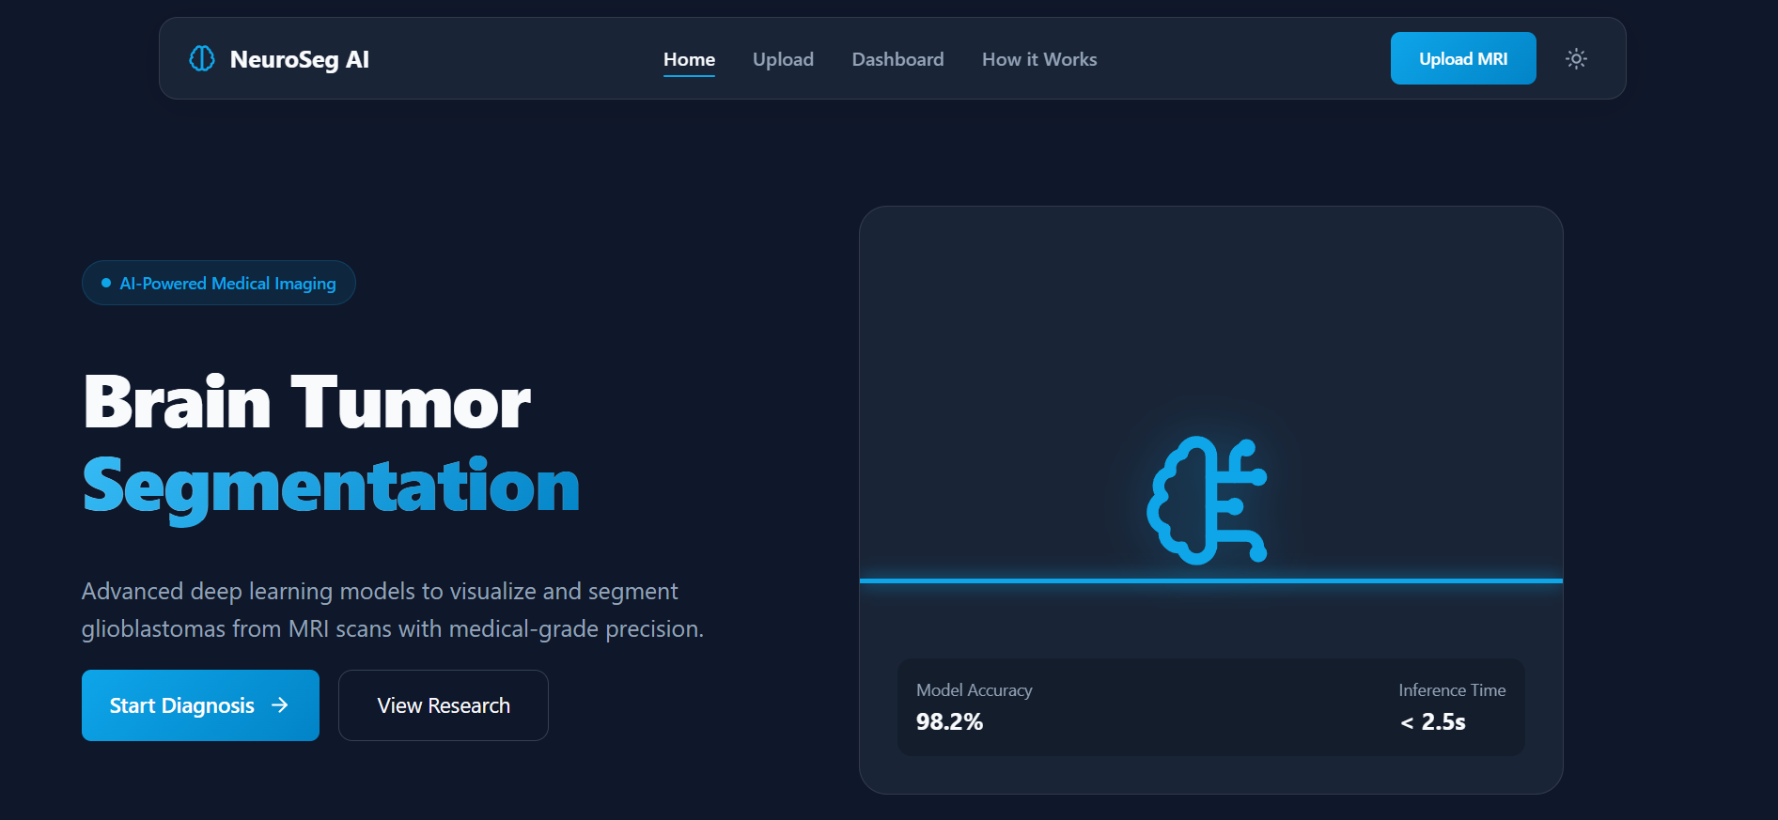
DEPLOYMENT: BEYOND THE NOTEBOOK

Slide 19


CONCLUSION
We didn't just build a model; we engineered a resilient system optimized for constraints.
Next Steps: Deploying on edge devices in rural hospitals to democratize access to precision diagnostics.
Q&A

Slide 20

Let’s Try Our Website
https://neuroseg_ai.datacraft.in.net/

